Slide 1
Identifying Periodic Occurrences of a Template with Applications to Protein Structure
Vincent A. Fischetti, Gad M. Landau
Peter H. Sellers, and Jeanette P. Schmidt
Information Processing Letters, Vol. 45,
pp. 11-18, 1993.

Slide 2
Abstract
Consider a template P of size m in which each character matches many different characters with various degrees of perfection. Given a text T of size n, we present a simple and practical algorithm that finds the substring of T, which best matches some substring of P^{n} (P^{n} is the concatenation of an arbitrary number of copies of P). The algorithm produces the matched pair and their alignment in O(mn) time.

Slide 3
The problem
We are given:
(a) A text T = t₁…t_{n} over an alphabetΣ₁.
(b) A pattern P = p₁…p_{m} over an alphabetΣ₂ .
(c) A penalty matrix M, defined overΣ₁×Σ₂ , with positive/negative values for good/bad matches.
(d) A gap function G, defined over all pairs (τ, ρ) whereτis a substring of T andρis a substring of any cyclic rotation of P.

Slide 4

The gap function
G(i₁, i₂, j₁, j₂), for 0 < i₁ ≤ i₂ ≤ n and 0 ≤ j₁, j₂ ≤ m, is the penalty for deleting the substring t _{i1+1 …} t _{i2} and p_{j1+1 …} p_{j2} .
G(i, i, j, j) = 0
For i₁ < i₂ or j₁≠j₂ , G(i₁, i₂, j₁, j₂) ≤ 0
i₁ ≤ i ≤ i₂ , and j₁, j, j₂
|G(i₁, i₂, j₁, j₂)| ≤ |G(i₁, i, j₁, j)| + |G(i, i₂, j, j₂)|

Slide 5
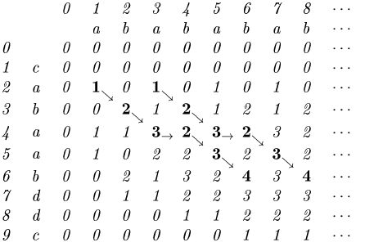
A simple but inefficient algorithm
Complexity:
O( m n ²)

Slide 6
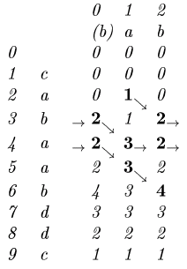
The new algorithm
Complexity:
O( m n )

Slide 7
Proof
Assume D[1…i-1;1…m] has been correctly computed.
t_{i} matches p_{j}
D[i, j] = D[i -1, j -1] + M[t_{i}, p_{j}]
Obtained from D[l, k] , delete t_{l+1}…t_{i} and p_{k+1}…p_{j} (No deletion in P if k = j)
D[i, j] = D[l, k] + G(l, i, k, j)
Obtained from D[i, k] and delete p_{k+1}…p_{j}
D[i, j] = D[i, k] + G(i, i, k, j)

